Slide 1
Data Lakes
The Basics
Justin Larson
10/28/2017

Slide 2
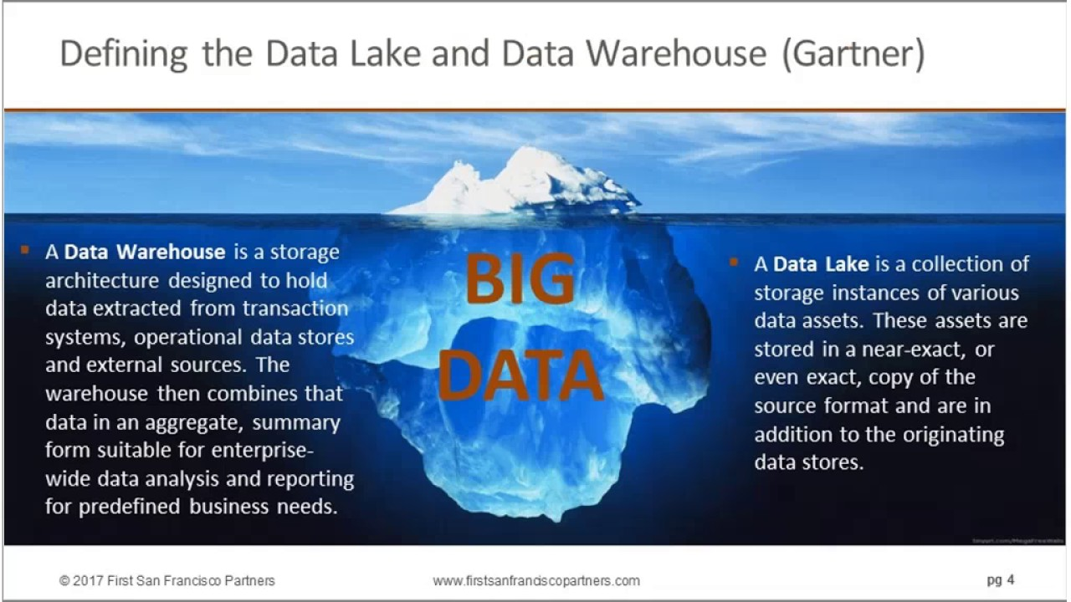

Slide 3
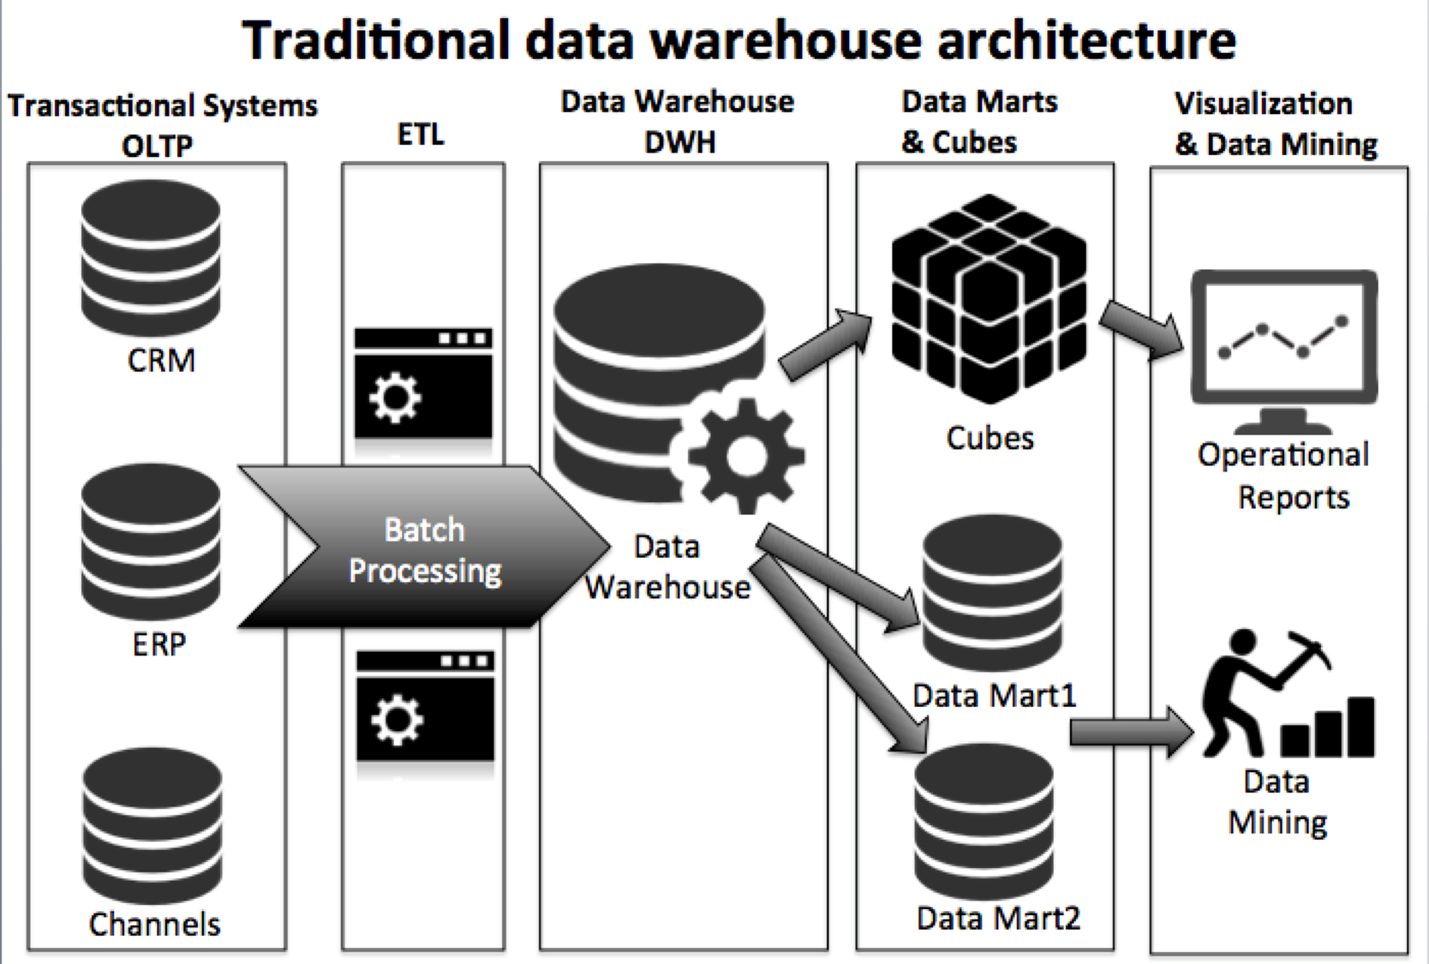
What Problem are they designed to solve?
Data too big
Data too complex
Solution too reliant on design-in-advance

Slide 4
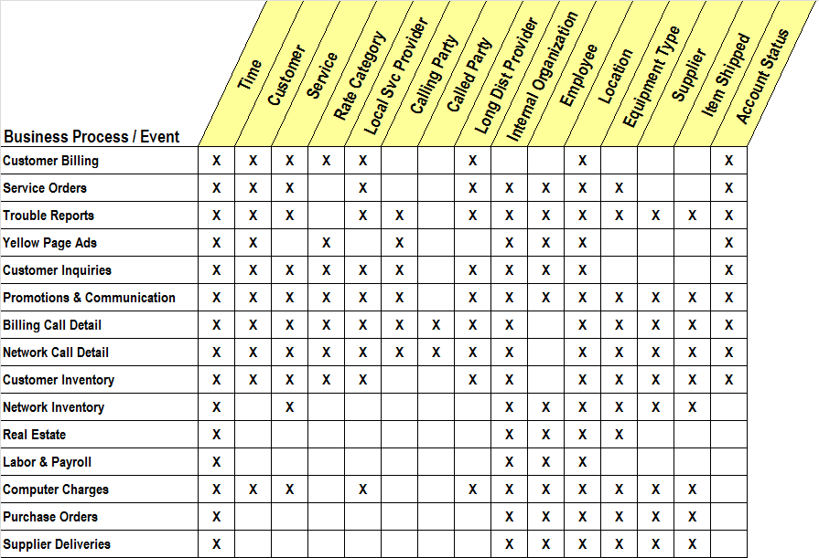
Enterprise Bus
Case in point
Key tenant to EDW, and every part must be designed

Slide 5
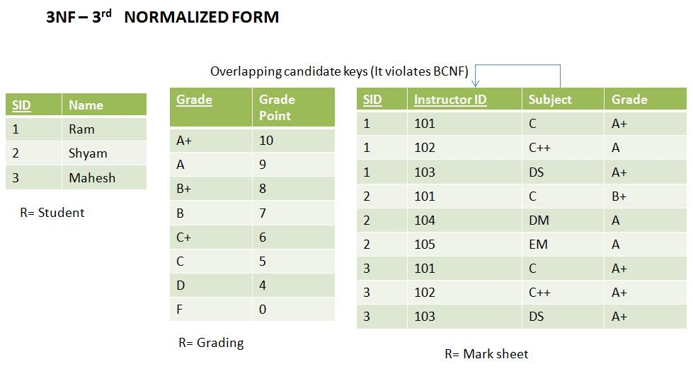
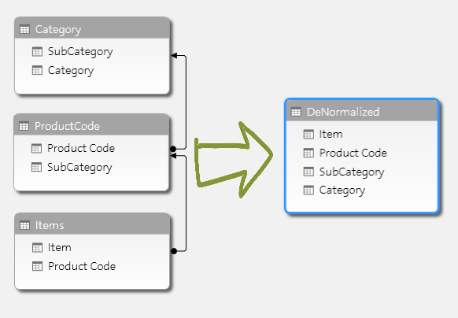
Data Management Basics
OLTP
3NF
EDW/OLAP
Denormalization

Slide 6
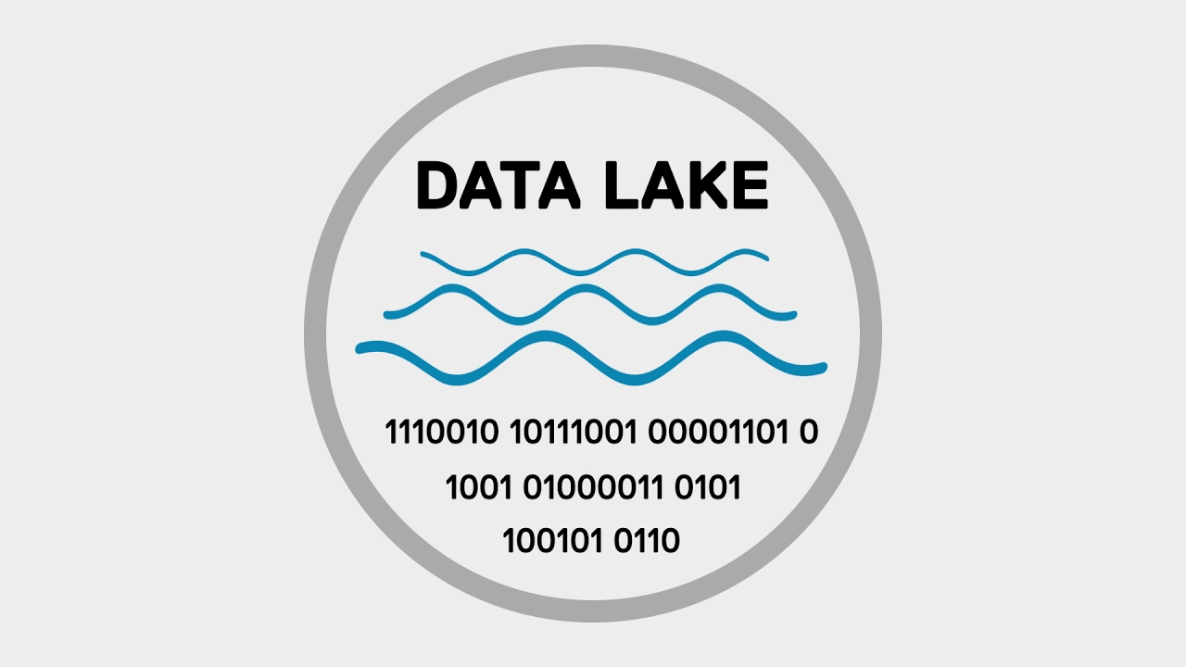
Lake
No implicit structure

Slide 7
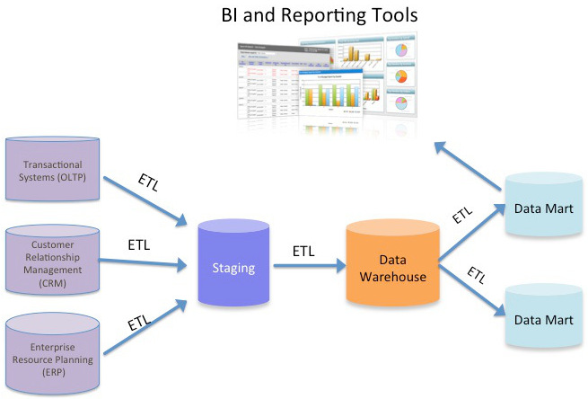
EDW
Centralization
Conformity
Speed
Governance and Security

Slide 8
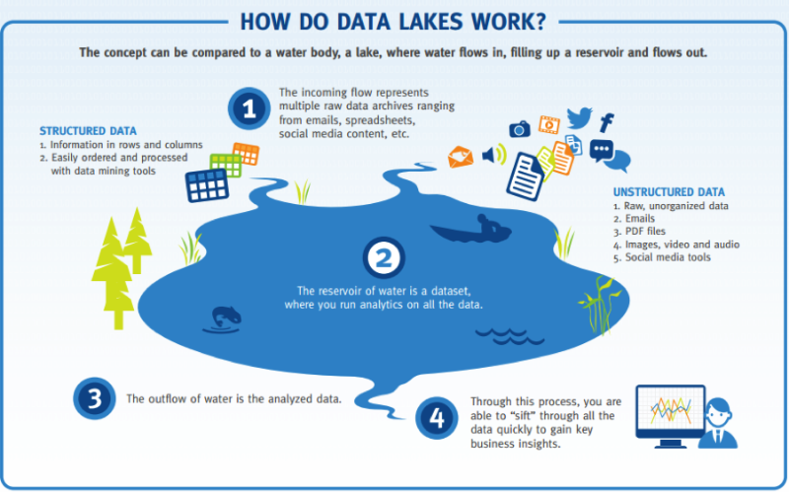
Data Lake
New Paradigm
Same Goal

Slide 9
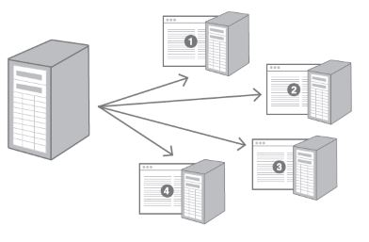
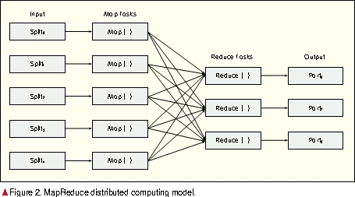
Distributed Compute – the new model
Server Model
Distributed Computation

Slide 10
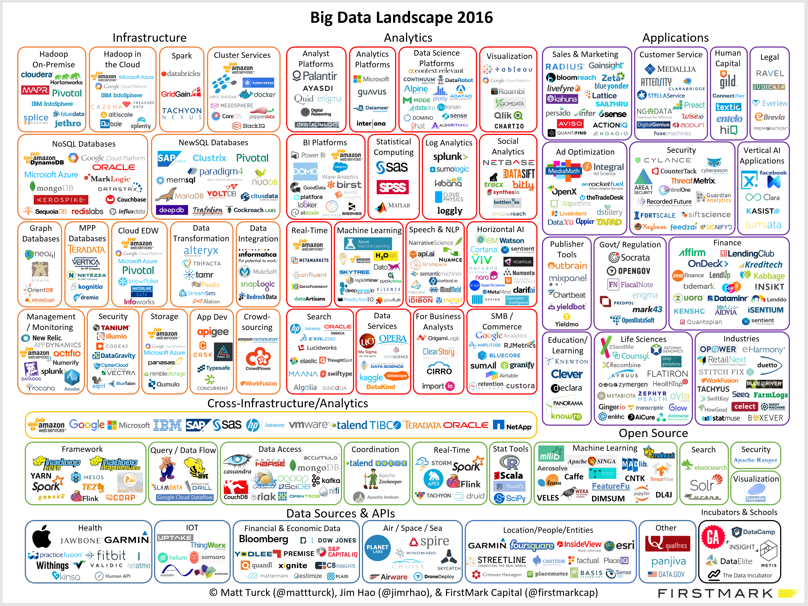
“Big” is growing

Slide 11
The next Freud will be a data scientist. The next Marx will be a data scientist. The next Salk might very well be a data scientist.
Seth Stephens-Davidowitz, Everybody Lies: Big Data, New Data, and What the Internet Can Tell Us About Who We Really Are

